Slide 1
The application of deep learning in radiology

Slide 2
ANN NGUYEN
Bachelor of Diagnostic Radiography
Master of Business Administration (Finance)
Certificate in Data Science/AI
Aspired Data Scientist

Slide 3
AGENDA
Introduction
Analysis
Modelling
Next steps and Summary

Slide 4
AGENDA
Introduction
Analysis
Modelling
Next steps and Summary

Slide 5
Introduction
67% of medical errors in Australia comes from the field of medical imaging
32% of imaging diagnostic errors come from the misinterpretation of chest radiographs
40-50% of X-rays performed are Chest x-ray
WHY?
Radiologist shortage: only 2% of radiologists are able to fulfill their reporting requirements within contracted hours.
COST
$millions annually for diagnostic errors
Detection of abnormalities in Chest X-ray using Deep Learning
Notes:
Medical errors have always been a topic of concern within the healthcare industry for years as human errors are inevitable but are definitely something that can be limited. In Australia, around 67% of the medical errors come from the field of medical imaging, in which 32% the errors come from the misinterpretation of chest radiographs. The statistics are quite surprising when around half of the xrays performed every year are chest xrays and we would expect our radiologists to be experts in interpreting them.
So why is this happening?
Radiologist shortage is an issue that the healthcare system has been trying to tackle for years. Radiologists are often assigned with such enormous workload that only 2% of them are able to fulfill their reporting requirements within contracted hours.
The exhaustion from being overworked can easily lead to human errors that cost the healthcare system millions annually.

Slide 6
Introduction
GOAL:
Reduce the cost of mis-diagnosis of Chest X-ray caused by the shortage of radiologists around the world.
APPROACH:
Develop a model that can aid in the detection of abnormalities in CXR.
Detection of abnormalities in Chest X-ray using Deep Learning
Notes:
The goal of this project is to reduce the cost misdiagnosis od Chest Xray that is caused largely by the shortage of radiologists around the world.
This is done through building a model that can aid in the detection of abnormalities in CXR and differentiate between the most commonly seen pathologies including Tuberculosis (TB), COVID-19 and Pneumonia.

Slide 7

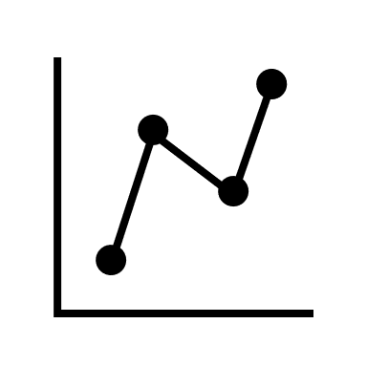


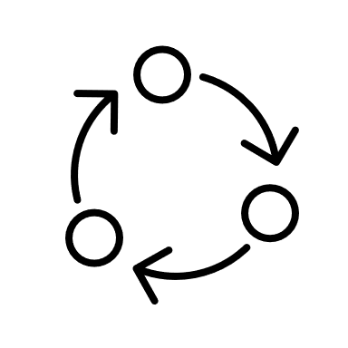
Process workflow
Goals & Objectives
EDA
Feature engineering
Modelling
Validation
Detection of abnormalities in Chest X-ray using Deep Learning
Notes:
The project pipeline will start with defining a goal and objective, then we move on to exploring the data, then perform feature engineering, modelling and model validation

Slide 8
AGENDA
Introduction
Analysis
Modelling
Next steps and Summary
Notes:
We will now move on to the EDA part

Slide 9
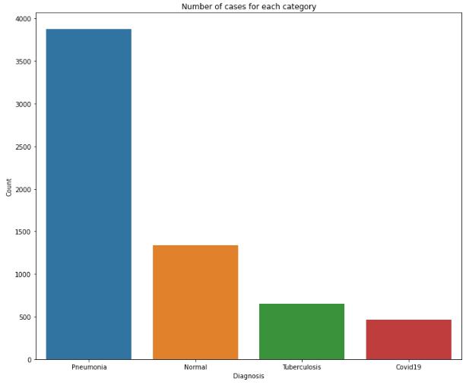
Exploratory Data analysis (eda)
Data retrieved from Kaggle, last updated 4 months ago
COVID19: public sources + hospitals + clinicians
PNEUMONIA: Guangzhou Women and Children’s Medical Center
TUBERCULOSIS: Qatar University
NORMAL: from both ‘Pneumonia’ and ‘Tuberculosis’ dataset
2 folders of Train and Test
Train: 4 classes, total 6326 images
Test: 4 classes, total 771 images
Class imbalance with majority of data belongs to the ‘Pneumonia’ category
Detection of abnormalities in Chest X-ray using Deep Learning
Notes:
The dataset used for this project was retrieved from Kaggle and it was last updated 4 months ago. Images for COVID19 were collected from public sources with some images come directly from hospitals and clinicians. Pneumonia group was collected from the Guangzhou Women and Children’s Medical Center. Images for Tuberculosis were donated by Qatar University and the Normal folder was normal xrays from both pneumonia and tuberculosis dataset.
Images are split in two folders of Train and Test. Each folder contains images from 4 classes of pathology including covid19, pneumonia, tuberculosis, and normal. The training set has a total of 6300 images and the test set has around 770 images.
The graph to our right demonstrates the total number of cases for each category. We can clearly see a high class imbalance here with a majority of the images belong to the pneumonia category.

Slide 10
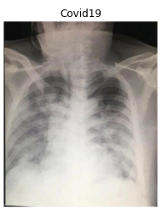
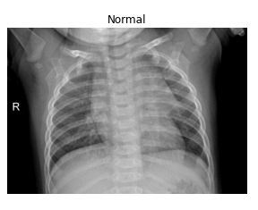
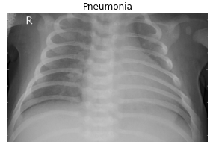
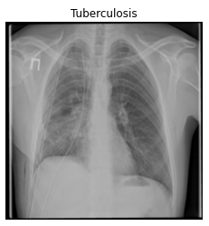
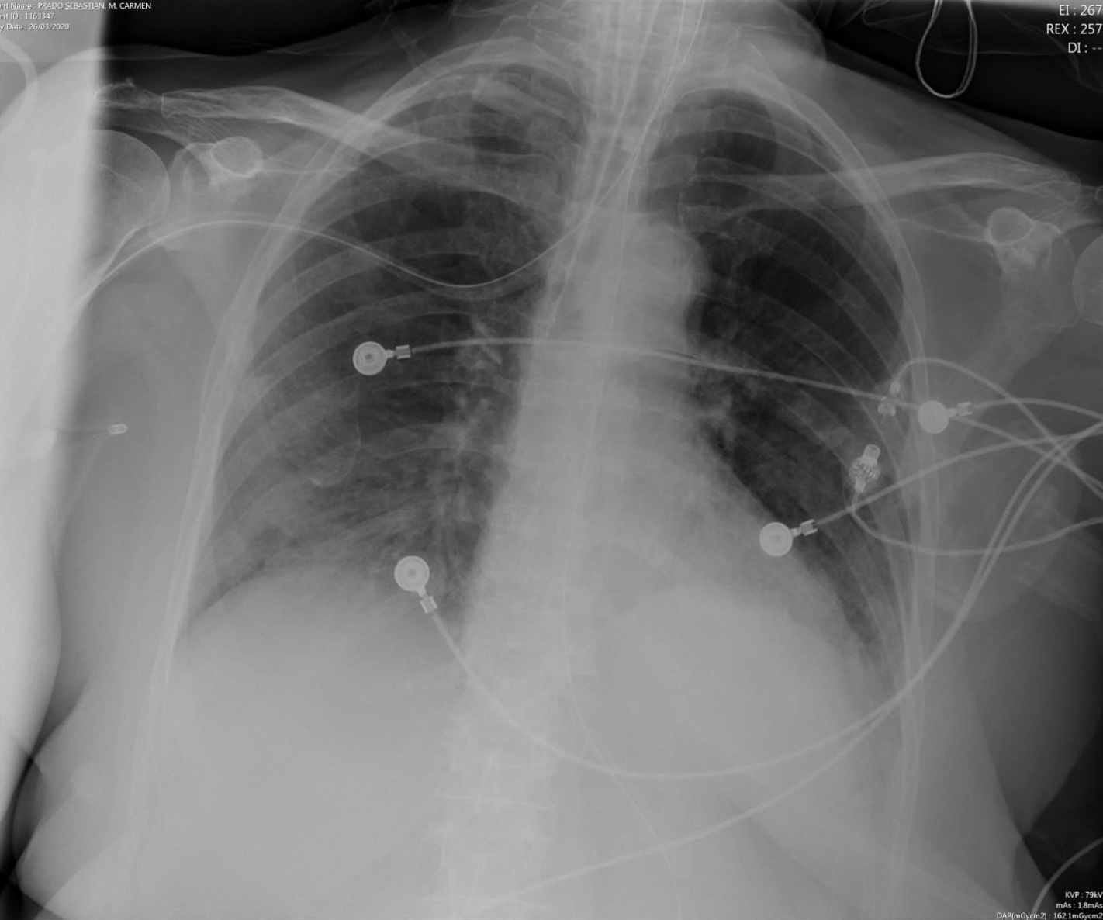
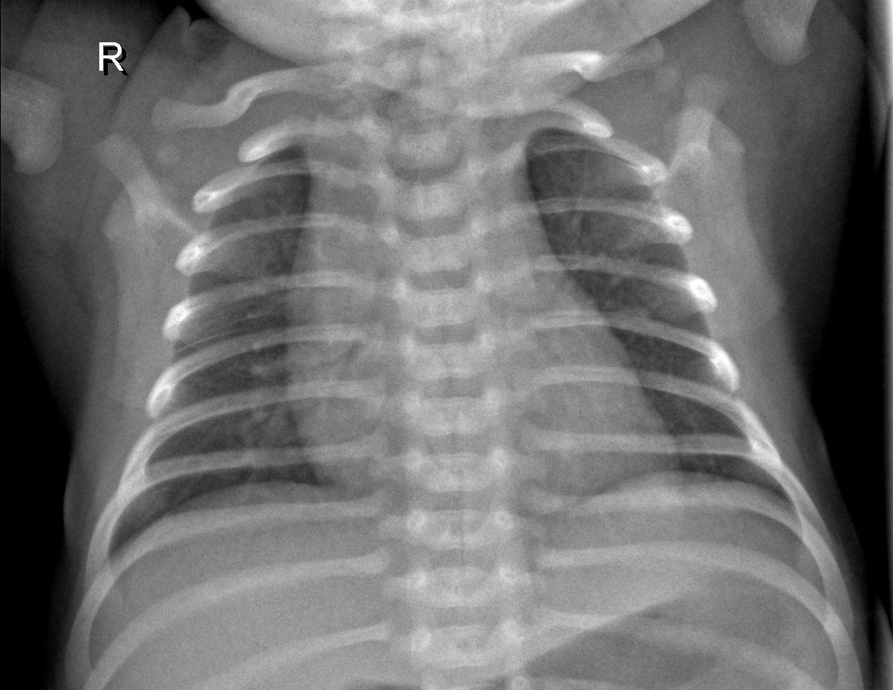
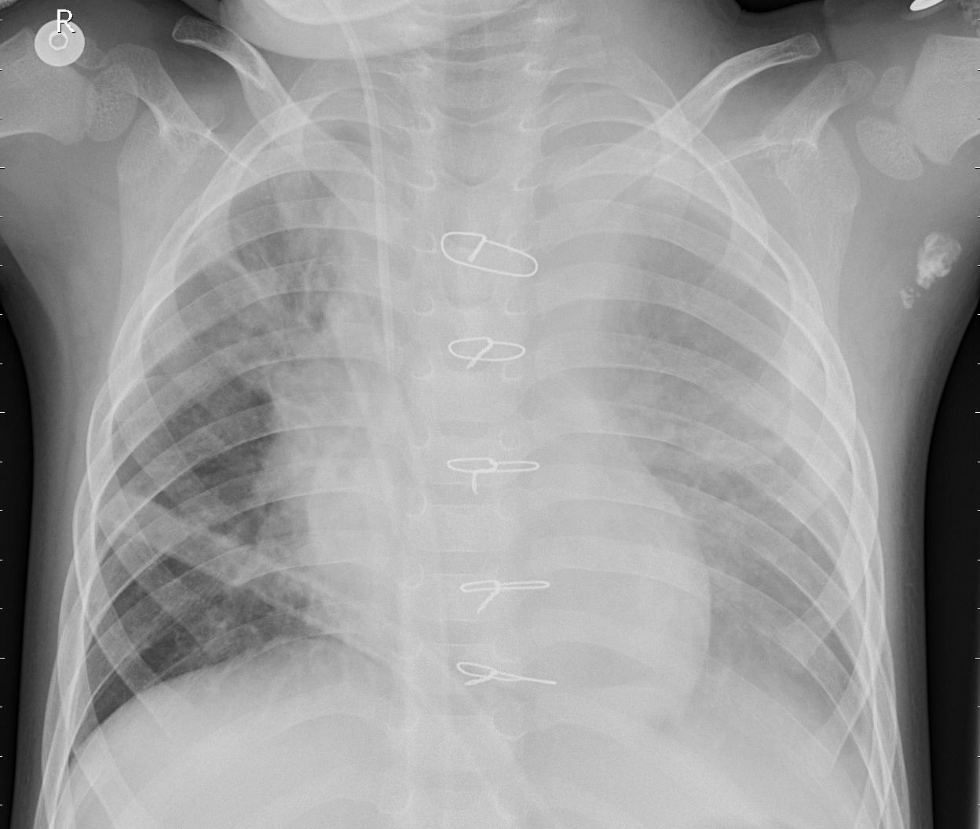
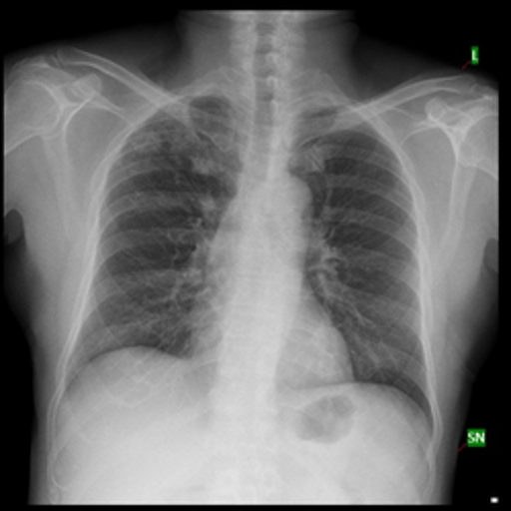
Exploratory Data analysis (eda)
Detection of abnormalities in Chest X-ray using Deep Learning
Notes:
So how can we tell these pathologies apart? Round nodules around the apex are usually seen in patients with tuberculosis. It is quite hard to differentiate covid19 and pneumonia as covid has a similar appearance to pneumonia in chest radiographs in most cases. But in general, there will be an area of haziness in the chest if pneumonia is present.
From the 8 sample xrays here, we can see that the appearance of the images vary broadly. Some is quite bright, some include artefact (foreign objects) like wires and tubes, some are paediatric (kids) xrays, some get cut off at the top or on the side. All these factors can affect the overall performance of the model.

Slide 11
Data preprocessing
 | COVID19 | NORMAL | PNEUMONIA | TUBERCULOSIS
Dimension | 823x685 | 1075x1554 | 488x760 | 512x512
Pixel range | 0-255 | 0-255 | 0-255 | 0-0.85
Mean | 154.2 | 104.7 | 130.62 | 0.5
SD | 61.74 | 63.15 | 39.82 | 0.18
Image Data Generator:
Rotation
Width shift
Height shift
Zoom
Shear
Horizontal flip
Brightness
Rescale
Detection of abnormalities in Chest X-ray using Deep Learning
Notes:
As can be seen in this table, these images also have different height and width, different pixel range with different mean and standard deviation pixel values.
Keeping all that in mind, the images had been preprocessed using Image Data Generator. Some metrics that have been altered include rotation, width shift, zoom, shear, vertical flip, brightness and rescale.

Slide 12
AGENDA
Introduction
Analysis
Modelling
Next steps and Summary

Slide 13
Modelling
 | Accuracy | Precision | Recall
Custom model | 51% | 13% | 25%
EfficientNetB0 | 51% | 13% | 25%
ResNet50 | 51% | 13% | 25%
DenseNet121 | 88% | 92% | 88%
InceptionV3 | 79% | 83% | 80%
Detection of abnormalities in Chest X-ray using Deep Learning
Notes:
A total of 5 models were built for this project. They include a custom model, an efficientnetb0, a resnet50, a densenet121 and an inceptionv3. As we can see from the table, DenseNet121 provides a model with a highest accuracy of 88%. Precision and Recall are also the highest out of all at 92% and 88% respectively.

Slide 14
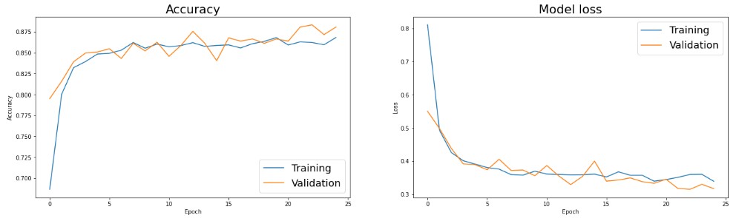
Densenet121
Detection of abnormalities in Chest X-ray using Deep Learning
Notes:
The two graphs here show the model’s accuracy and loss over 25 epochs. As we can see, the accuracy of the training and validation sets increases and are pretty much converged at around the 3th epoch. This is also similar to the loss function where they also converge after 3 epochs.

Slide 15
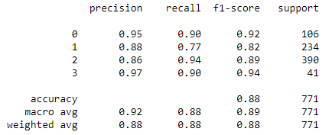
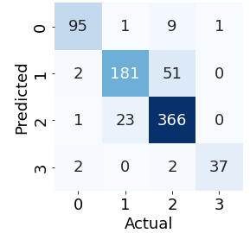
Densenet121
{0 : COVID19,
1 : NORMAL,
2 : PNEUMONIA,
3 : TUBERCULOSIS}
Detection of abnormalities in Chest X-ray using Deep Learning
Notes:
The image to your left is the classification report for DenseNet model. Precision describes how many detected items are truly relevant and recall measures how many relevant elements were detected.
First, let’s look at the recall rate for each class. We can see that the model is very sensitive to class 0, 2, and 3, which are ‘Covid19’, ‘pneumonia’, and ‘tuberculosis’ respectively. The model is not the best in detecting normal xrays with a recall rate of only 77%. Some might argue that the only inconvenience in diagnosing a normal xray as abnormal is that the patient will have to comeback for further testing, but we should also consider the fact that the most common subsequent test to chest xray is CT scan. This means that there might be a chance that a completely healthy patient might have to be exposed to unnecessary radiation if this model is being used as the only source of diagnosis.
Now let’s look at the precision of the model. Both Covid19 and Tuberculosis have a precision of above 90%. The precision for Normal and Pneumonia is slightly lower at 88% and 86% respectively. This is also demonstrated in the confusion matrix where we can see that most of the incorrectly labelled images are in the normal and pneumonia group.

Slide 16
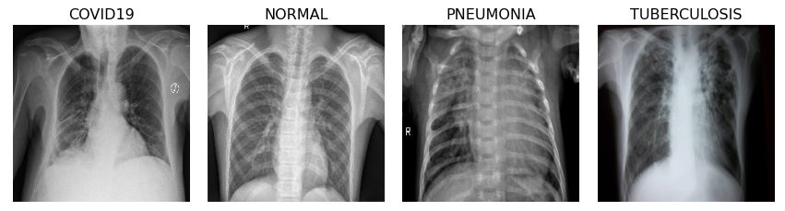
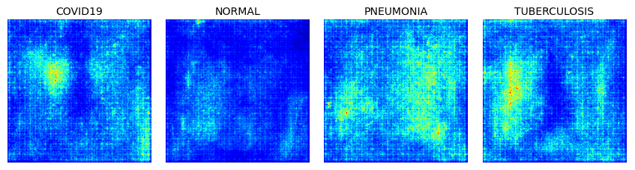
Visualisation of Neural Network
Sample of each group from Test folder
Saliency map
Detection of abnormalities in Chest X-ray using Deep Learning
Notes:
The saliency map is built so that we can have a better visualisation on how densenet detects anomalies in chest xray. The upper row contains sample image that are correctly labelled by neural network from each group, from the test folder. Each image is then fed into the neural network to yield the saliency map. We can see that for COVID19, PNEUMONIA and TUBERCULOSIS, the model did detect some regions of interest which are highlighted in yellow and green. Whereas in the normal xray, nothing lights up indicating that there is no area of suspicion according to the network.

Slide 17
AGENDA
Introduction
Analysis
Modelling
Next steps and Summary

Slide 18
Future work
Data Preprocess:
Image enhancement (Histogram equalization, Contrast limited adaptive histogram equalization, Image invert, Gamma correction)
Modelling:
ChexNet (model specifically built to train on X-ray images)
potentially save $Millions
88% accuracy
Detection of abnormalities in Chest X-ray using Deep Learning
Notes:
So what will be our next steps?
We can attempt to improve the performance of the model with image enhancement techniques include histogram equalization, contrast limited adaptive histogram equalization, image invert/complement and gamma correction.
ChexNet is a model that is being built to specifically train on X-ray images. The model is built upon the current DenseNet121 application. This can be the model to consider in the future.
With an 88% accuracy, it is hopeful that millions of $ will be saved from the medical errors bill. In addition to that, many lives will be saved from the successful implementation of the model in daily medical practice.

Slide 19
Resources
https://www.kaggle.com/datasets/jtiptj/chest-xray-pneumoniacovid19tuberculosis?resource=download
https://www.kaggle.com/code/adrynh/xray-classification-keras
https://laurenoakdenrayner.com/2017/12/18/the-chestxray14-dataset-problems
https://arxiv.org/ftp/arxiv/papers/2012/2012.02238.pdf
https://onlinelibrary.wiley.com/doi/10.5694/mja2.51077
Detection of abnormalities in Chest X-ray using Deep Learning

Slide 20
THANK YOU
Ann Nguyen
ann.ngoc.phuong.nguyen@gmail.com
Detection of abnormalities in Chest X-ray using Deep Learning

